Slide 1

Unpaired Image-to-Image Translation
with CycleGAN
（ICCV 2017）
Jun-Yan Zhu and Taesung Park
Joint work with Phillip Isola and Alexei A. Efros

Slide 2
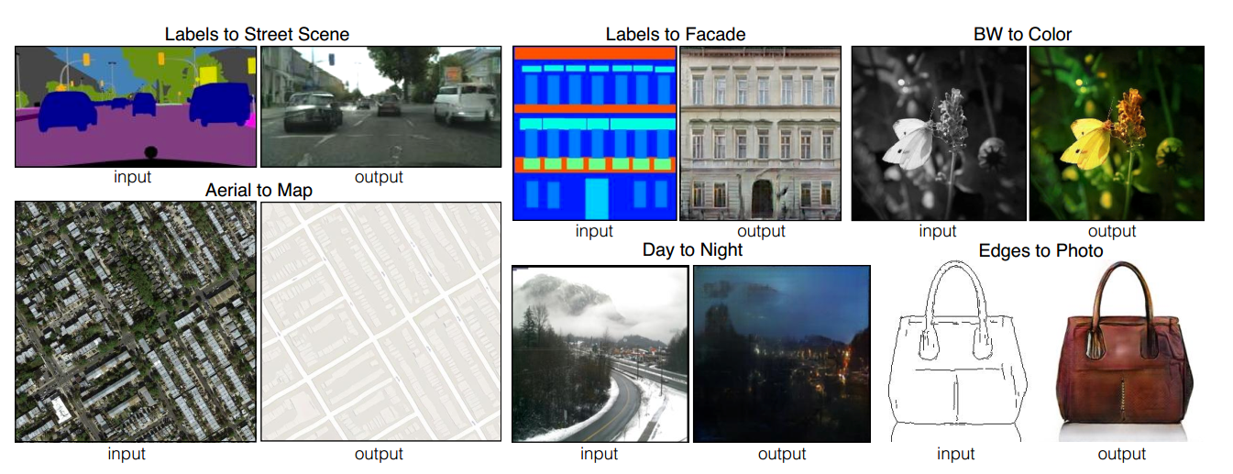
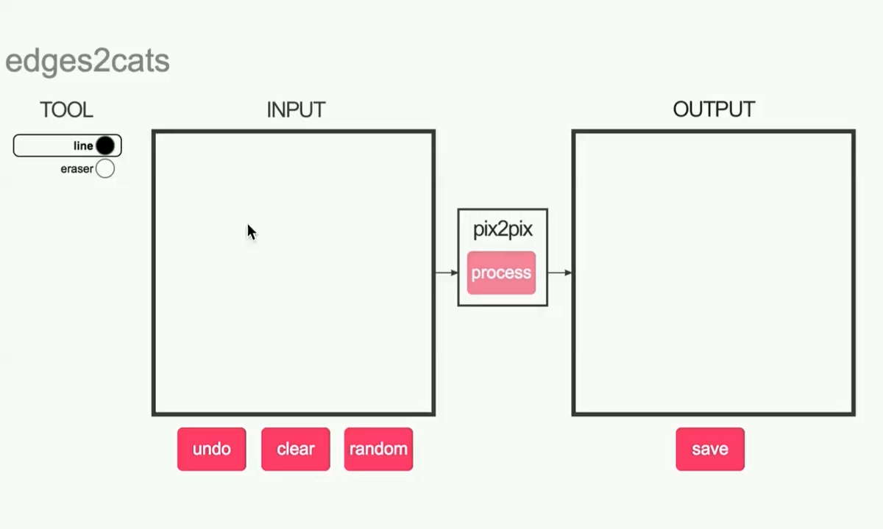
Image-to-Image Translation with pix2pix
Image-to-image Translation with Conditional Adversarial Nets
Phillip Isola, Jun-Yan Zhu, Tinghui Zhou, Alexei A. Efros. CVPR 2017

Slide 3
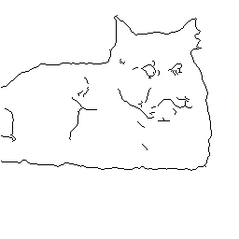
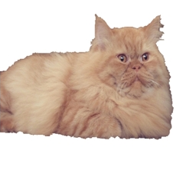
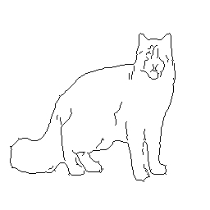
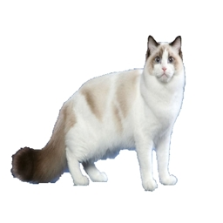
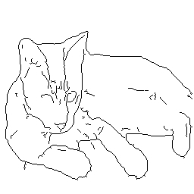
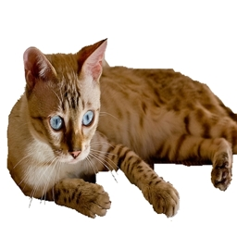

Paired
$$⋯$$

Slide 4
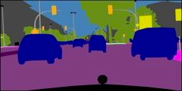
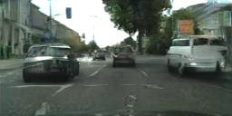
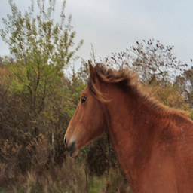

Paired
Label $↔$ photo: per-pixel labeling
Horse $↔$ zebra: how to get zebras?
- Expensive to collect pairs.
- Impossible in many scenarios.
$$⋯$$

Slide 5
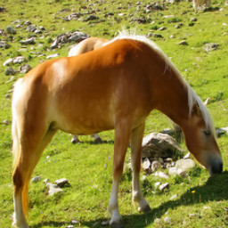
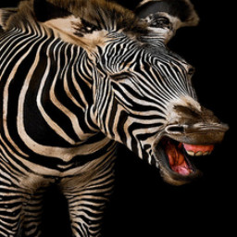
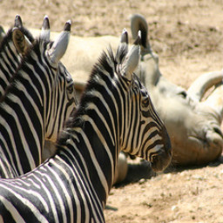
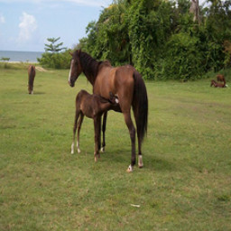
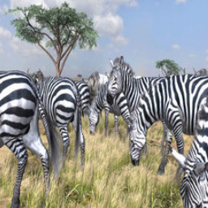
Paired
Unpaired
…
…
$$⋯$$

Slide 6
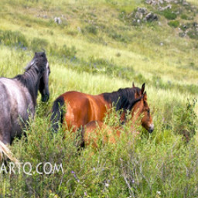
$$x$$
$$G(x)$$
$$G$$
Generator
$$D$$
No input-output pairs!

Slide 7
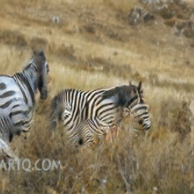
$$x$$
$$G(x)$$
$$G$$
$$D$$
Real!
Generator
Discriminator

Slide 8
$$x$$
$$G(x)$$
$$G$$
$$D$$
Real too!
Generator
Discriminator
GANs do not force output to correspond to input

Slide 9
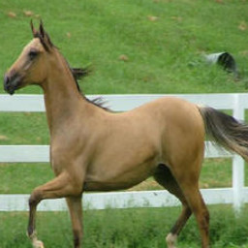
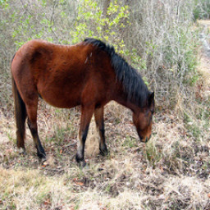
mode collapse!

Slide 10
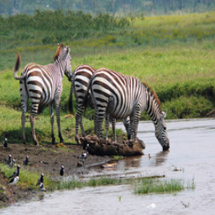
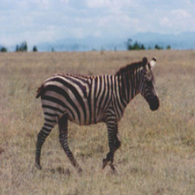


Cycle-Consistent Adversarial Networks
$$⋯$$
$$⋯$$
[Zhu*, Park*, Isola, and Efros, ICCV 2017]

Slide 11


Cycle-Consistent Adversarial Networks
$$⋯$$
[Mark Twain, 1903]
$$⋯$$
[Zhu*, Park*, Isola, and Efros, ICCV 2017]

Slide 12


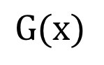
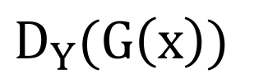
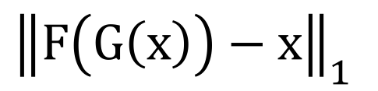
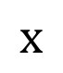
Cycle-Consistent Adversarial Networks
$$x$$
$$G(x)$$
$$F(G\left(x\right))$$
$$D_{Y}(G\left(x\right))$$
Reconstruction
error
$${\left\|F\left(G\left(x\right)\right)−x\right\|}_{1}$$
[Zhu*, Park*, Isola, and Efros, ICCV 2017]

Slide 13
Cycle Consistency Loss
Large cycle loss
Small cycle loss
$$x$$
$$G(x)$$
$$F(G\left(x\right))$$
$$D_{Y}(G\left(x\right))$$
Reconstruction
error
$${\left\|F\left(G\left(x\right)\right)−x\right\|}_{1}$$
[Zhu*, Park*, Isola, and Efros, ICCV 2017]

Slide 14
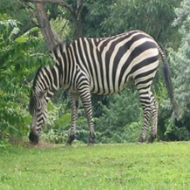
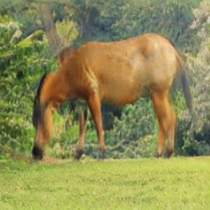
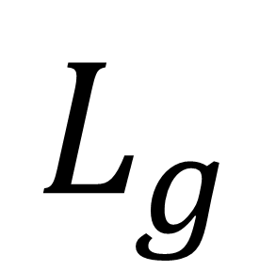
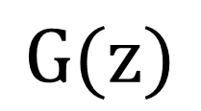
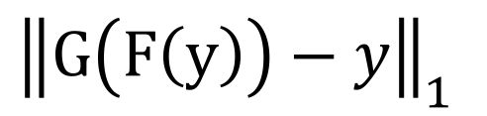
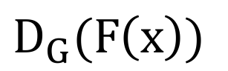

Cycle Consistency Loss
$$x$$
$$G(x)$$
$$F(G\left(x\right))$$
$$y$$
$$F(y)$$
$$G(F\left(x\right))$$
$$D_{Y}(G\left(x\right))$$
$$D_{G}(F\left(x\right))$$
Reconstruction
error
Reconstruction
error
$${\left\|F\left(G\left(x\right)\right)−x\right\|}_{1}$$
$${\left\|G\left(F\left(y\right)\right)−y\right\|}_{1}$$
See similar formulations [Yi et al. 2017], [Kim et al. 2017]
[Zhu*, Park*, Isola, and Efros, ICCV 2017]

Slide 15
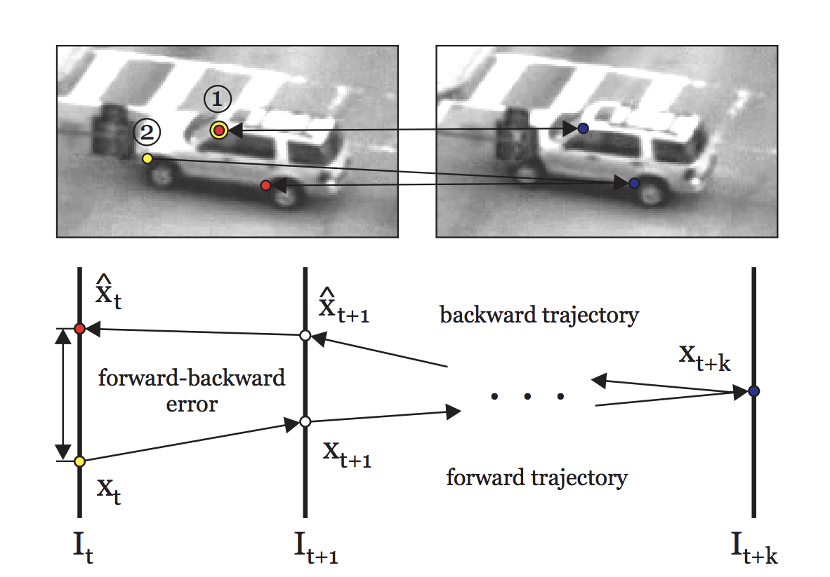
Cycle Consistency in Vision
Consistent Track
Inconsistent Track
Forward-Backward Error: Automatic Detection of Tracking Failures. ICPR 10’
Zdenek Kalal, Krystian Mikolajczyk, and Jiri Matas.
Also see [Sundaram, Brox, Keutzer, ECCV 10’]

Slide 16
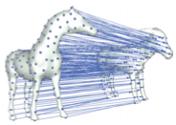
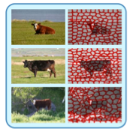
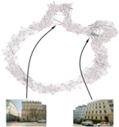
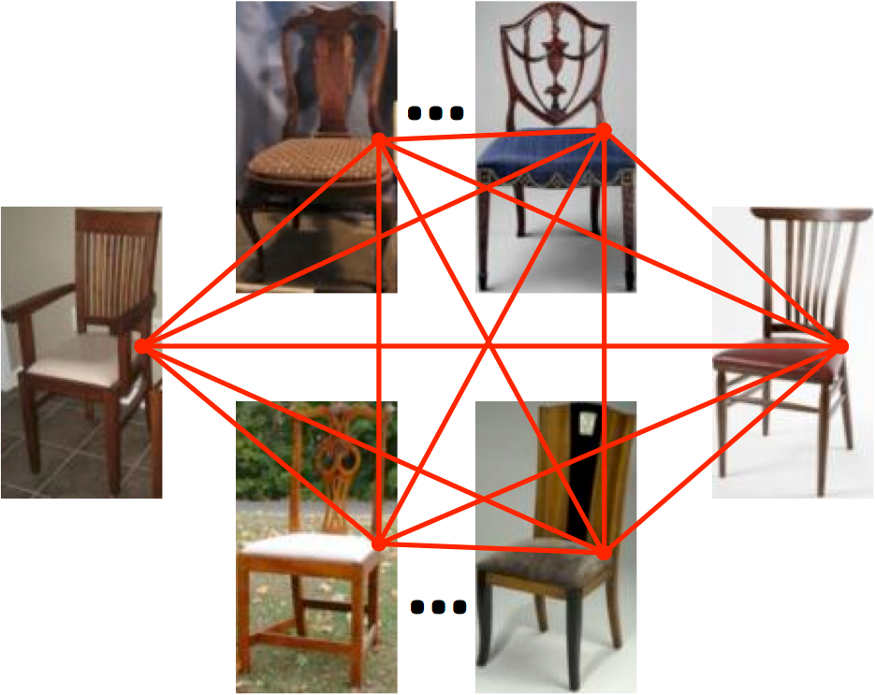
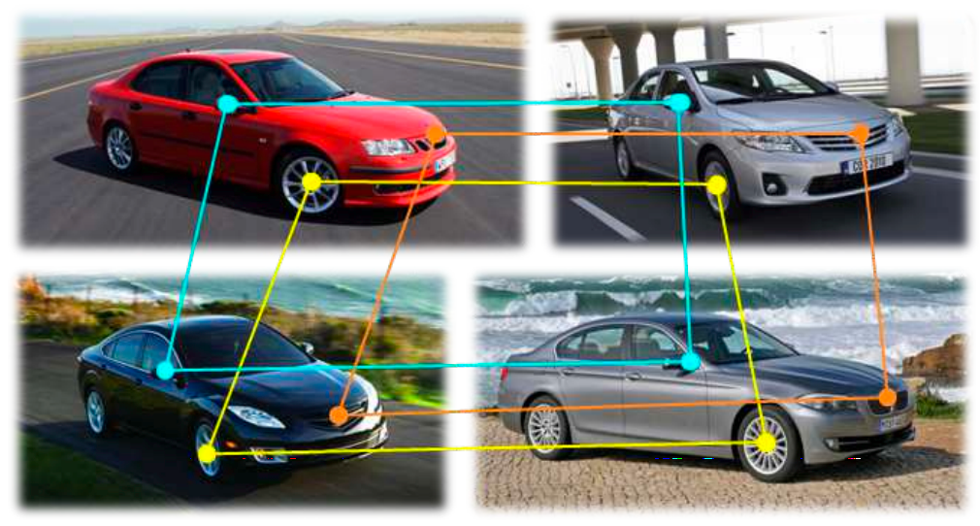
Cycle Consistency in Vision
Shape Matching
Co-segmentation
SfM
Huang et al, SGP’13
Wang et al, ICCV’13
Zach et al, CVPR’10
Collection Correspondence
Zhou et al, CVPR’15
Zhou et al, ICCV’15
slides credit @Tinghui Zhou

Slide 17
Results

Slide 18
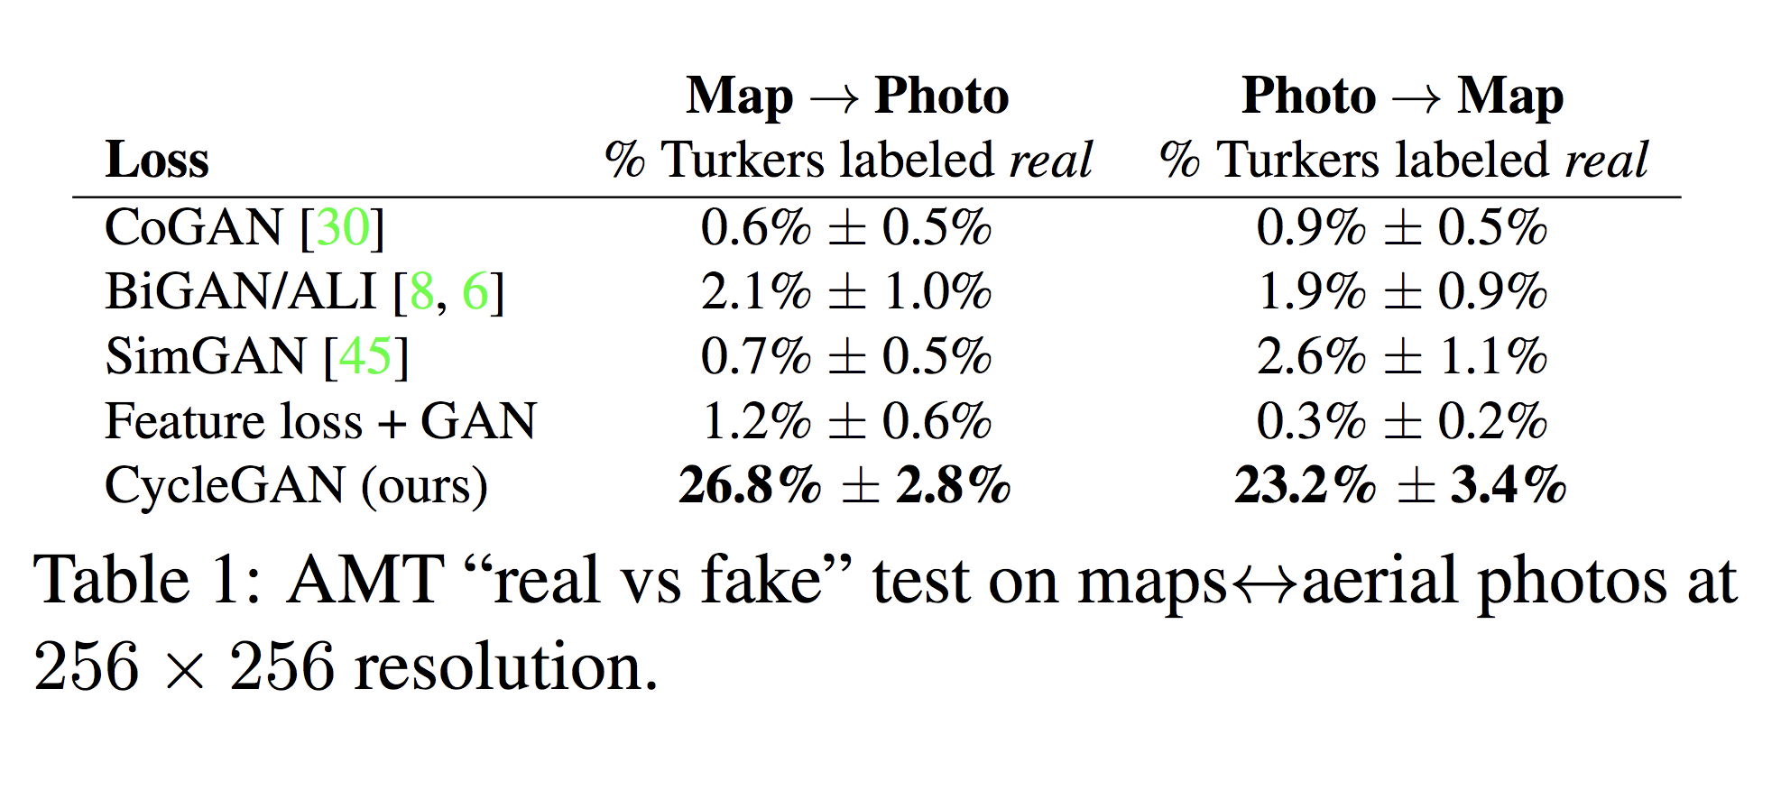
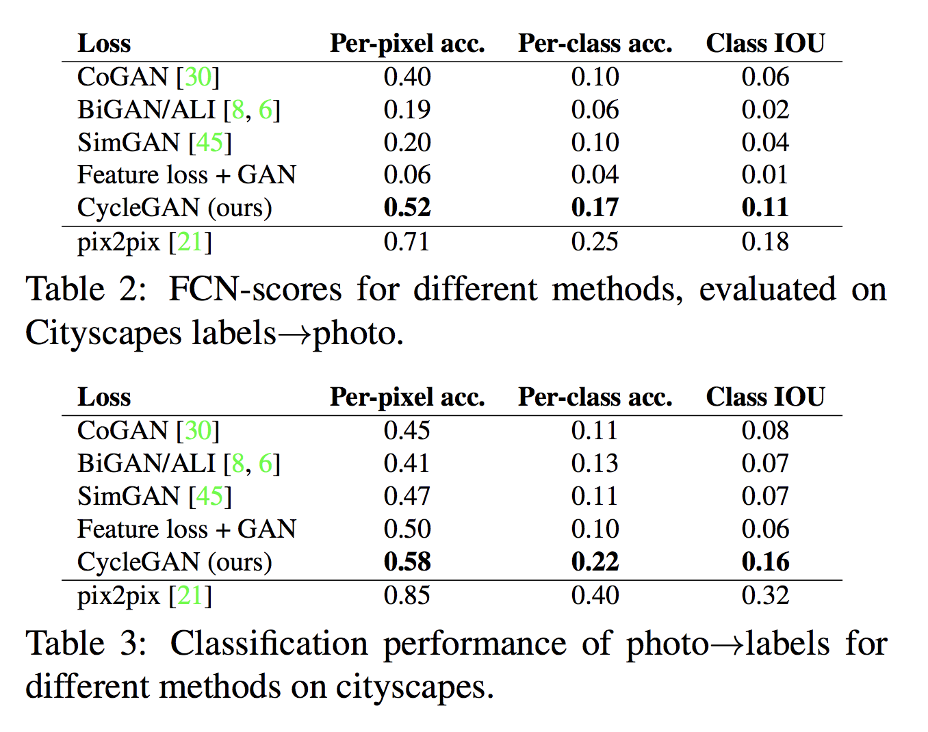
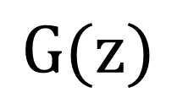

AMT ‘real vs fake’ test on maps $↔$ aerial
FCN scores on cityscapes labels$→$photos
Classification performance of photo$→$labels

Slide 19
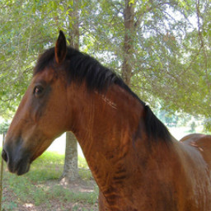
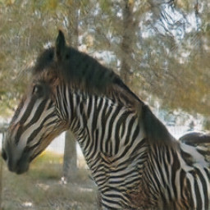
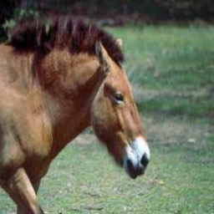
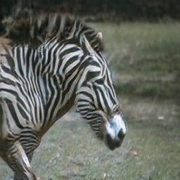

Slide 20
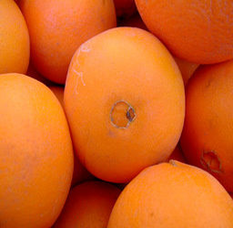
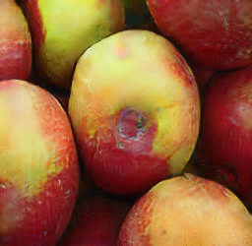
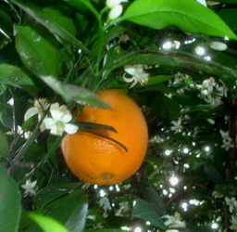
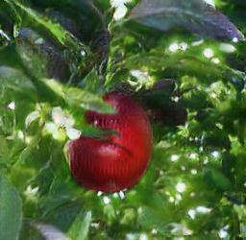

Slide 21
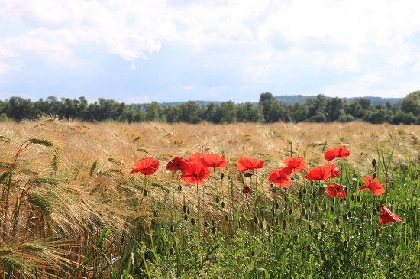




Collection Style Transfer
Monet
Van Gogh
Photograph
@ Alexei Efros
Cezanne
Ukiyo-e

Slide 22




















Input
Monet
Van Gogh
Cezanne
Ukiyo-e

Slide 23



Monet’s paintings $→$ photos

Slide 24




Monet’s paintings $→$ photos

Slide 25









Slide 26
Why CycleGAN works

Slide 27



Style and Content Separation
Paired Separation
Unpaired Separation
Content
Adversarial Loss: change the style
Style
Cycle Consistency Loss: preserve the content
Separating Style and Content with
Bilinear Models
[Tenenbaum and Freeman 2000’]
Two empirical assumptions:
- content is easy to keep.
- style is easy to change.

Slide 28



Neural Style Transfer [Gatys et al. 2015]
Style and Content:
Content: feature difference
Style: Gram Matrix difference
Both losses are hard-coded.

Slide 29
















Input
Style Image I
Style image II
Entire collection
CycleGAN
Photo $→$ Van Gogh
Input
Style image I
Style image II
Entire collection
CycleGAN
horse $→$ zebra

Slide 30


Cycle Loss upper bounds Conditional Entropy
Conditional Entropy
High Conditional Entropy
Low
Conditional Entropy
“ALICE: Towards Understanding Adversarial Learning for Joint Distribution Matching” [Li et al. NIPS 2017]. Also see [Tiao et al. 2018] “CycleGAN as Approximate Bayesian Inference”

Slide 31

Cycle Loss upper bounds Conditional Entropy
Conditional Entropy
“ALICE: Towards Understanding Adversarial Learning for Joint Distribution Matching” [Li et al. NIPS 2017]. Also see [Tiao et al. 2018] “CycleGAN as Approximate Bayesian Inference”

Slide 32


CycleGAN implementations
Torch
PyTorch
20+ implementations by researchers/developers:
Tensorflow, Chainer, mxnet, Lasagne, Keras…

Slide 33


CycleGAN at School
Taught at Stanford, UC Berkeley, UoT, Udacity, FastAI, etc.
Course assignment code and handout designed by Prof. Roger Grosse for CSC321 “Intro to Neural Networks and Machine Learning” at University of Toronto.

Slide 34
Applications

Slide 35




CG2Real: GTA5 $→$ real streetview
GTA5 CG Input
Output
Inspired by [Johnson et al. 2011]

Slide 36

Real2CG: real streetview $→$ GTA
Cityscape Input
Output

Slide 37

Synthetic Data as Supervision
GTA5 images
Segmentation labels
[Richter*, Vineet* et al. 2016] [Krähenbühl et al. 2018]

Slide 38


Domain Adaptation with CycleGAN
Train on GTA5 data
Test on real images
 | meanIOU | Per-pixel accuracy
Oracle (Train and test on Real) | 60.3 | 93.1
Train on CG, test on Real | 17.9 | 54.0
See Judy Hoffman’s talk at 14:30 “Adversarial Domain Adaptation”

Slide 39
Domain Adaptation with CycleGAN
GTA5 data + Domain adaptation
Test on real images
 | meanIOU | Per-pixel accuracy
Oracle (Train and test on Real) | 60.3 | 93.1
Train on CG, test on Real | 17.9 | 54.0
FCN in the wild [Previous STOA] | 27.1 | -
See Judy Hoffman’s talk at 14:30 “Adversarial Domain Adaptation”

Slide 40

Domain Adaptation with CycleGAN
Train on CycleGAN data
Test on real images
 | meanIOU | Per-pixel accuracy
Oracle (Train and test on Real) | 60.3 | 93.1
Train on CG, test on Real | 17.9 | 54.0
FCN in the wild [Previous STOA] | 27.1 | -
Train on CycleGAN, test on Real | 34.8 | 82.8
See Judy Hoffman’s talk at 14:30 “Adversarial Domain Adaptation”

Slide 41






Applications and Extentions
Attribute Editing [Lu et al.]
Object Editing [Liang et al.]
Low-res
Bald
Bangs
Mask
Input
Output
arXiv:1705.09966
arXiv:1708.00315
Front/Character Transfer [Ignatov et al.]
Data generation [Wang et al.]
Input
output
samples by CycleWGAN
arXiv: 1801.08624
arXiv:1707.03124

Slide 42


Photo Enhancement
WESPE: Weakly Supervised Photo Enhancer for Digital Cameras. arxiv 1709.01118
Andrey Ignatov, Nikolay Kobyshev, Kenneth Vanhoey, Radu Timofte, Luc Van Gool

Slide 43

Image Dehazing
Cycle-Dehaze: Enhanced CycleGAN for Single Image Dehazing. CVPRW 2018
Deniz Engin∗ Anıl Genc∗, Hazım Kemal Ekenel

Slide 44

Unsupervised Motion Retargeting
Neural Kinematic Networks for Unsupervised Motion Retargetting. CVPR 2018 (oral)
Ruben Villegas, Jimei Yang, Duygu Ceylan, Honglak Lee

Slide 45

Neural Kinematic Networks for Unsupervised Motion Retargetting. CVPR 2018 (oral)
Ruben Villegas, Jimei Yang, Duygu Ceylan, Honglak Lee

Slide 46
Applications Beyond Computer Vision
Medical Imaging and Biology [Wolterink et al., 2017]
Voice conversion [Fang et al., 2018, Kaneko et al., 2017]
Cryptography [CipherGAN: Gomez et al., ICLR 2018]
Robotics
NLP: Unsupervised machine translation.
NLP: Text style transfer.
…

Slide 47


Input MR
Generated CT
Ground truth CT

Slide 48
Problem with the paired MR-CT data
Images are not perfectly aligned
There are usually more unpaired data

Slide 49


Slide 50


Slide 51
Reconstucted Images

Slide 52

Reconstructed Images
Input
Output
Reconstruction

Slide 53

Reconstructed Images (Chu, Zhmoginov and Sandler, NIPSW 2017)
Input
Output
Reconstruction

Slide 54

Reconstructed Images (Chu, Zhmoginov and Sandler, NIPSW 2017)
Input
Output
Reconstruction
Output Variance
Real Map Variance

Slide 55
Failure cases

Slide 58




ImageNet
“Wild horse”

Slide 59


Slide 60
Beyond CycleGAN
Multi-modality
Style control
More than two domains

Slide 61
Beyond CycleGAN
Multi-modality
Style control
More than two domains

Slide 62



Beyond CycleGAN – Multi-modality
Almahairi et al., ICML 2018

Slide 63
















Beyond CycleGAN – Multi-modality
$$z_{b}$$
$${\tilde{z}}_{a}$$
$$z_{b}′$$
$$z_{a}$$
$${\tilde{z}}_{b}$$
$$z_{a}′$$
$$G_{AB}$$
$$G_{BA}$$
$$E_{A}$$
$$E_{B}$$
$a$
$\tilde{b}$
$a′$
$b$
$\tilde{a}$
$b′$
Almahairi et al., ICML 2018

Slide 64

Beyond CycleGAN – Multi-modality
Almahairi et al., ICML 2018

Slide 65
Beyond CycleGAN
Multi-modality
Style control
More than two domains

Slide 66


Beyond CycleGAN – Style Control
Chang et al., CVPR 2018

Slide 67










Beyond CycleGAN – Style Control
F
F
Reference $y$
Source $x$
$$G(x, y)$$
$$F(y)$$
Reference $y$
Source $x$
G
G
D_{y}
D_{x}
Chang et al., CVPR 2018

Slide 68

Beyond CycleGAN – Style Control
Chang et al., CVPR 2018

Slide 69
Beyond CycleGAN
Multi-modality
Style control
More than two domains

Slide 70

Beyond CycleGAN – More than 2 domains
Choi et al., CVPR 2018

Slide 71

Beyond CycleGAN – More than 2 domains
Choi et al., CVPR 2018

Slide 72

Beyond CycleGAN – More than 2 domains
Choi et al., CVPR 2018

Slide 73


Beyond CycleGAN – More than 2 domains
Anoosheh et al., CVPR 2018

Slide 74


Beyond CycleGAN – More than 2 domains
Anoosheh et al., CVPR 2018

Slide 75






#CycleGAN at Twitter
Monet $→$ Thomas Kinkade @David Fouhey
Resurrecting Ancient Cities @ Jack Clark
Birds @Matt Powell‏
Bear $→$ Panda @Matt Powell‏

Slide 76

Turn Real People Into Anime Art
@minjunli (Minjun Li), @Aixile (Yanghua JIN), @alanyttian (Yingtao Tian)

Slide 77


Latest from #CycleGAN
CycleGAN with architectural modifications, by itok_msi
https://qiita.com/itok_msi/items/b6b615bc28b1a720afd7

Slide 78

Thank You!
Code and data: junyanz.github.io/CycleGAN/

